Slide 1
Rainfall sensor Update
Keith Matthews

Slide 2
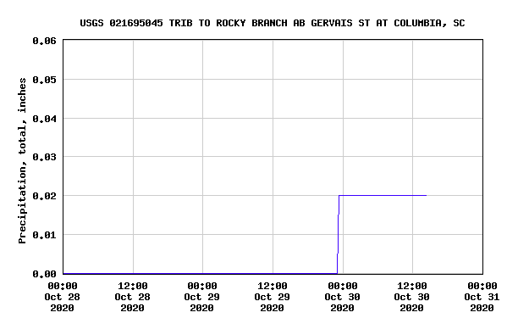
Data
USGS only registered 0.02 in rainfall event
USGS records rainfall for every quarter hour
Very windy
Increase sample size decrease the sample rate

Slide 3
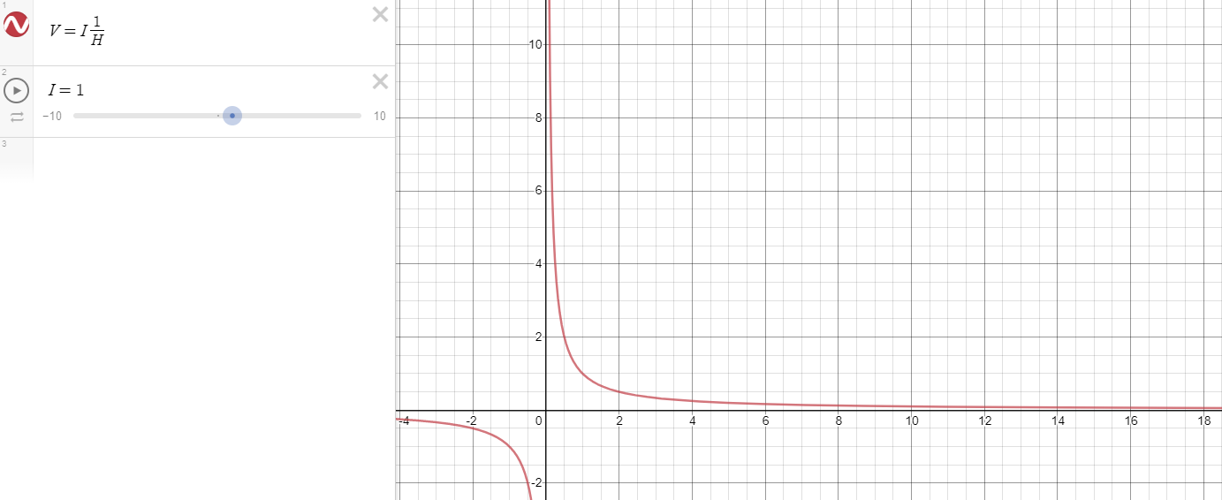
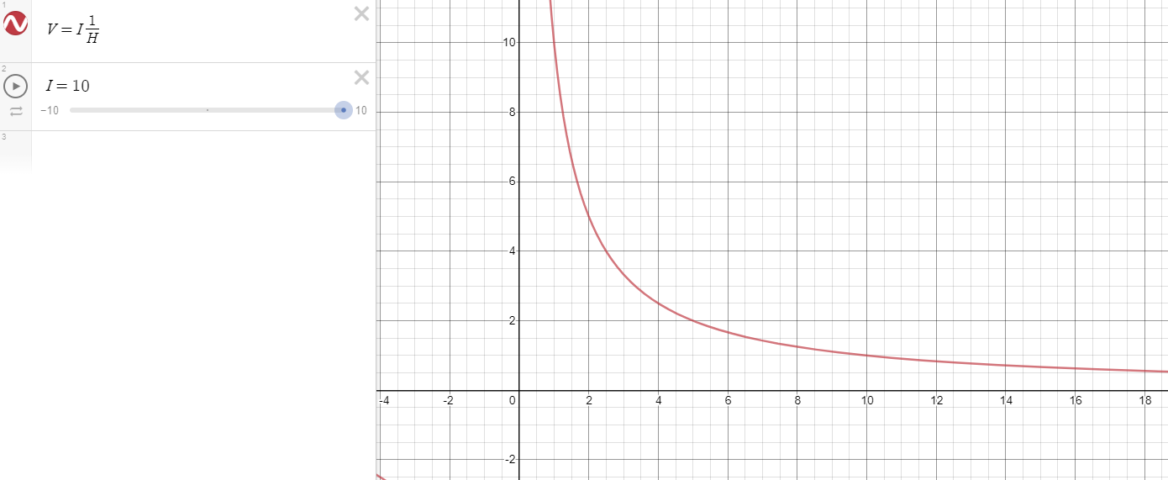
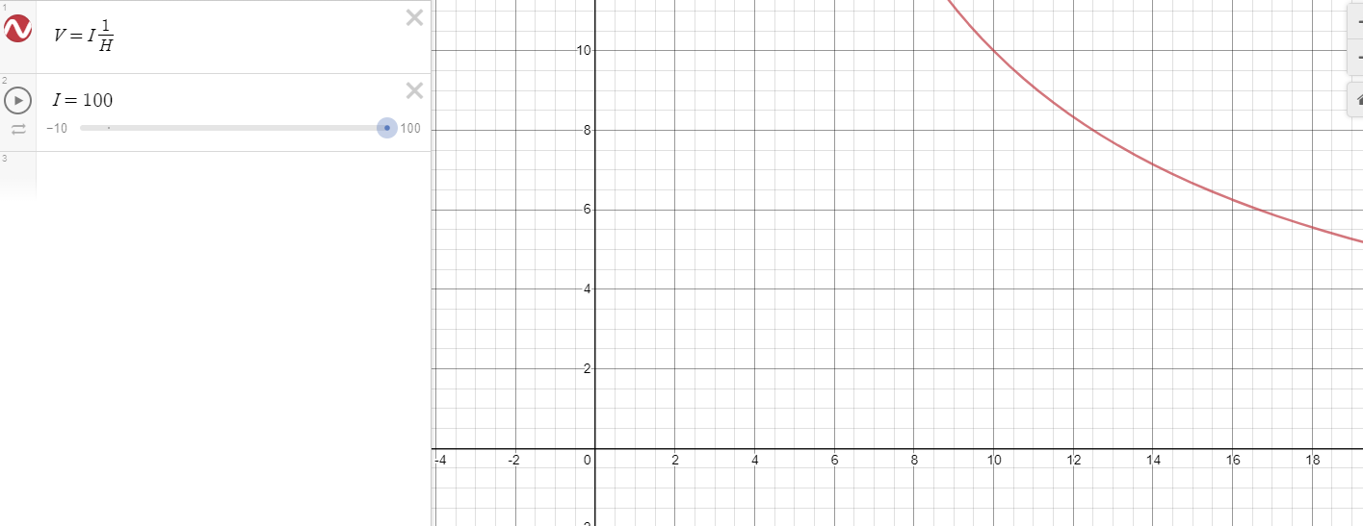
Redesign top piece
Deformation internal electrode holder
Due to heat
Make thicker and connect
Reciprocal Function
V=IR = I*(1/H)
Flatten the curve
Increase the current
Angle the electrodes?

Slide 4
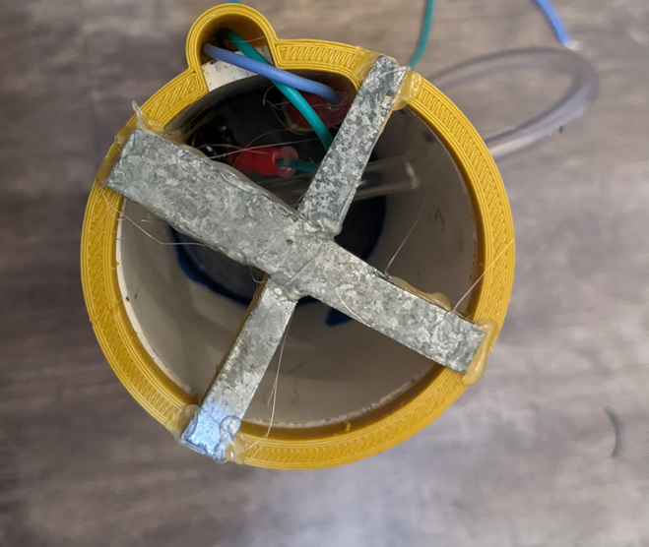
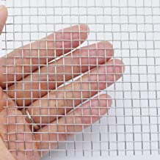
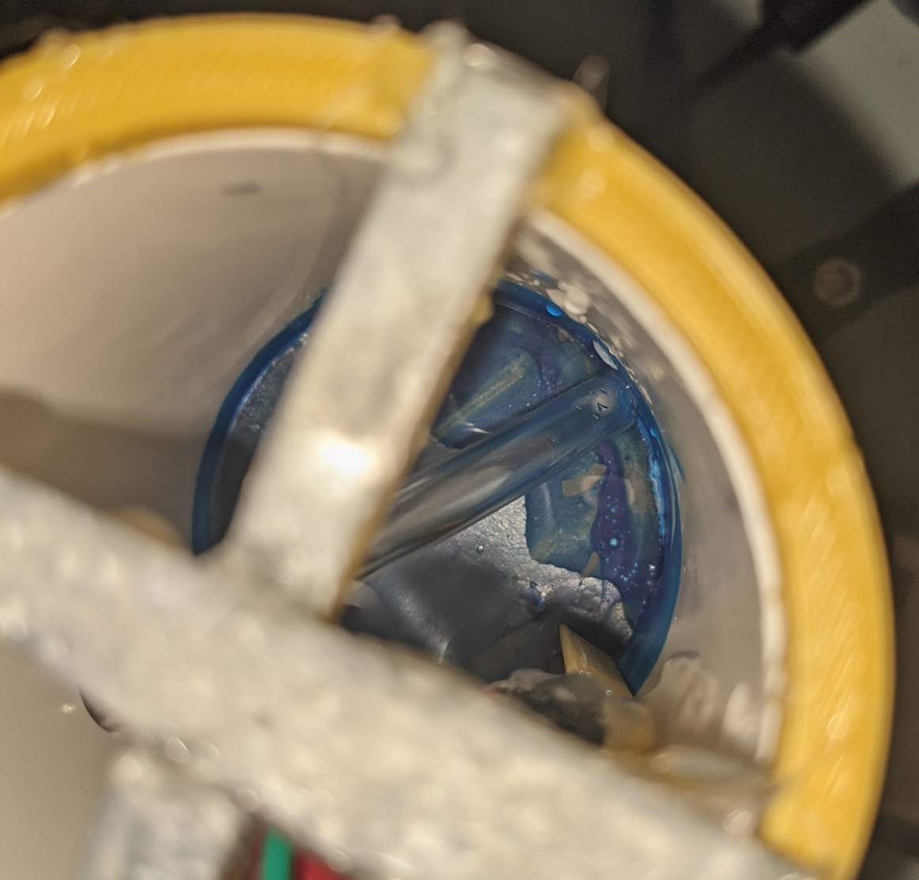
New top
Issues
Want resolution
Want a better capture ratio
Disrupted due to wind and drone docking port
Funnel intake
Increase SA?
Better for wind events
Reduced Height?
Magnetic mount area
Ferrous steel
400 grade SS
Mesh

Slide 5
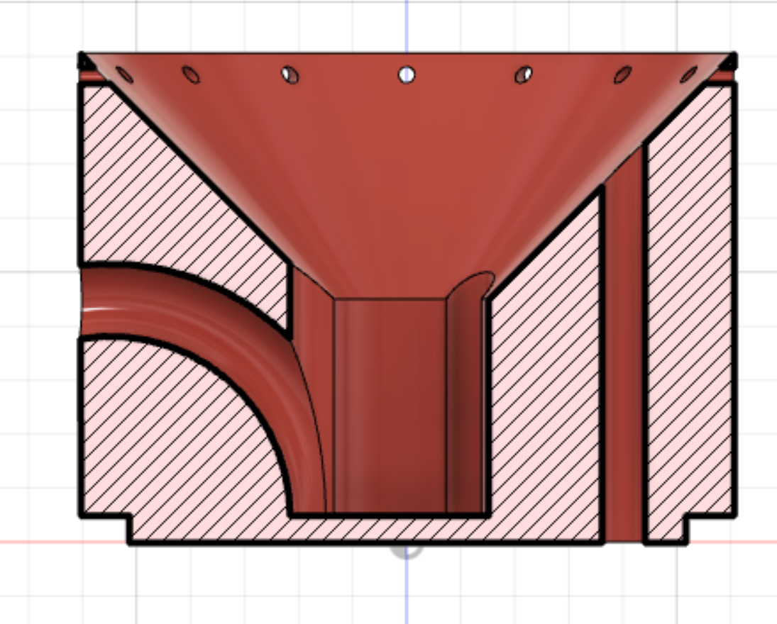
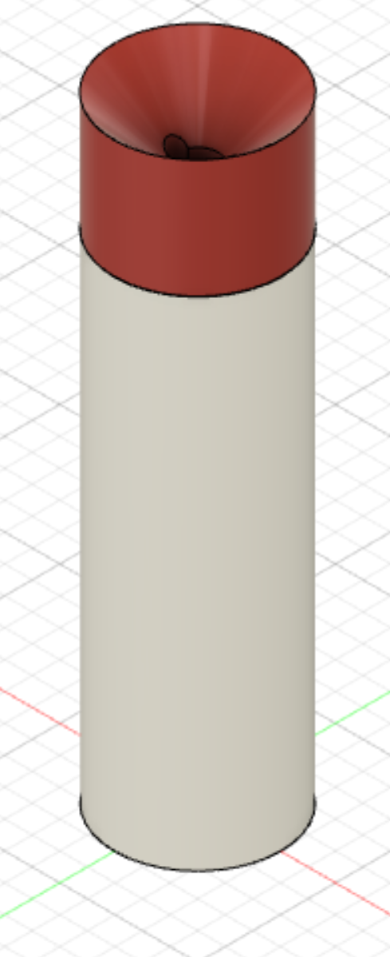
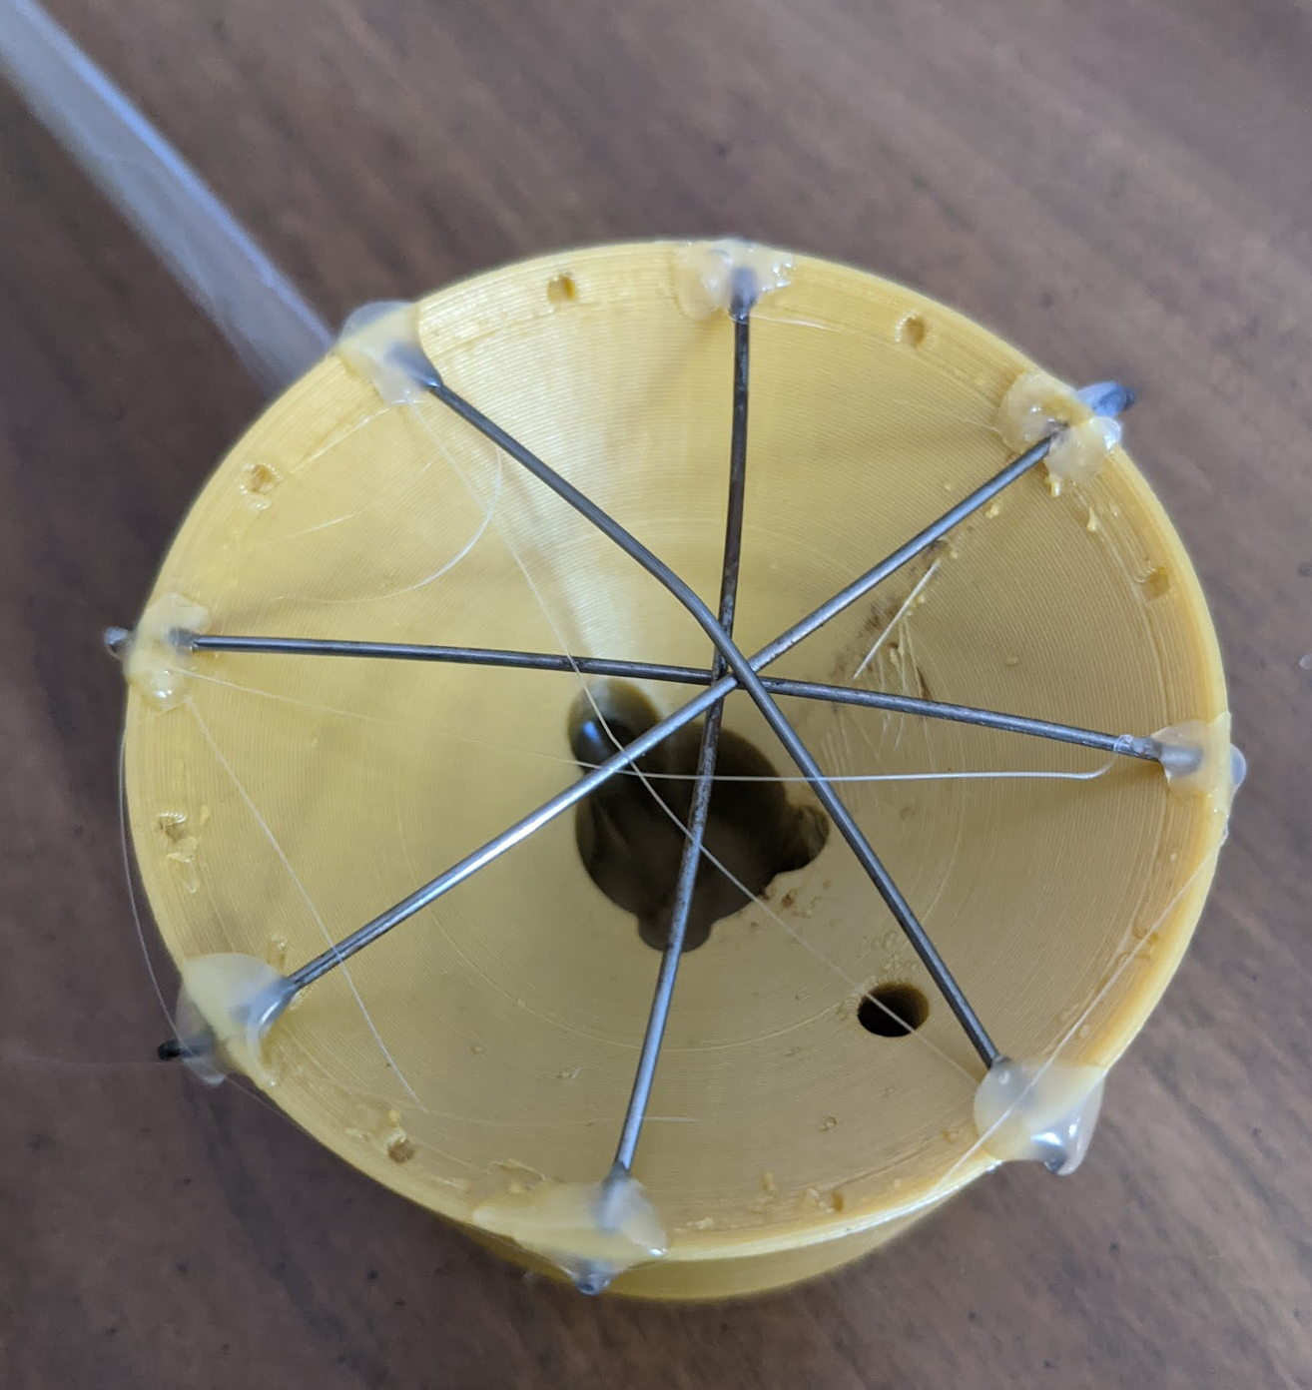
New top
Reduced overall height (reduction of 40mm)
Easier assembly
Internal wiring
More accurate data (ratio of ~16:1)

Slide 6
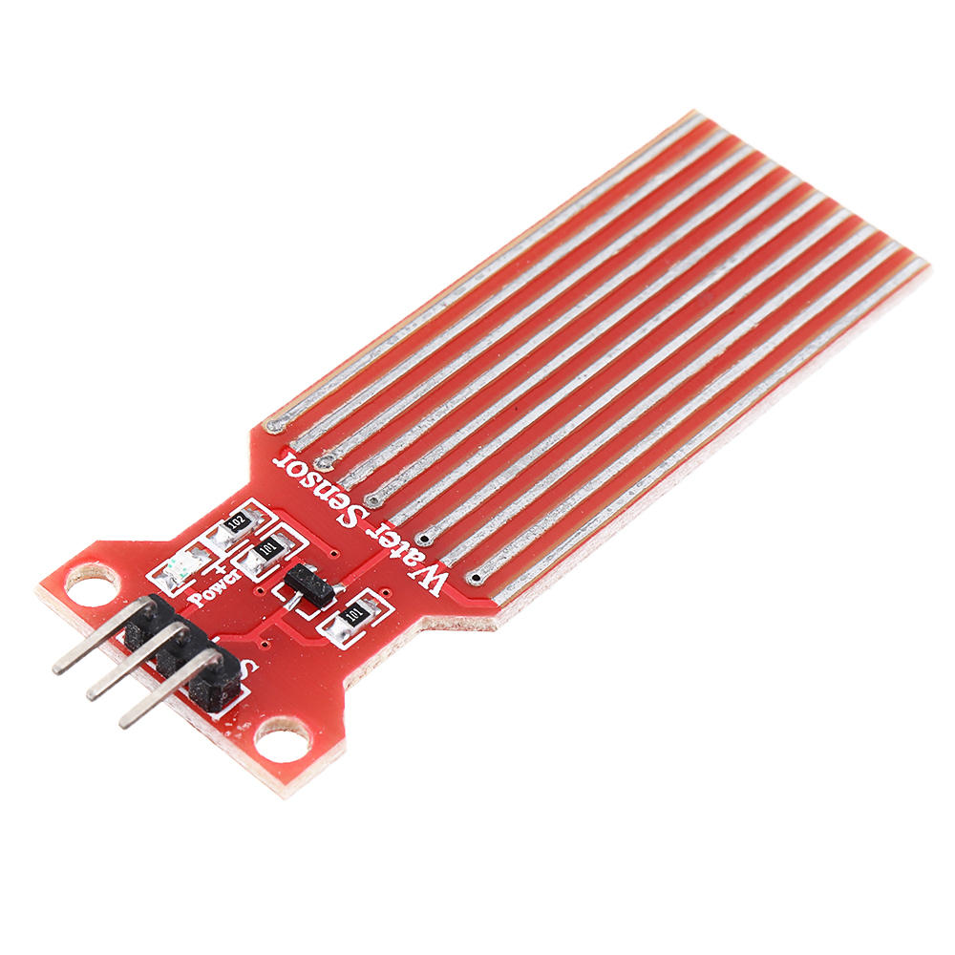
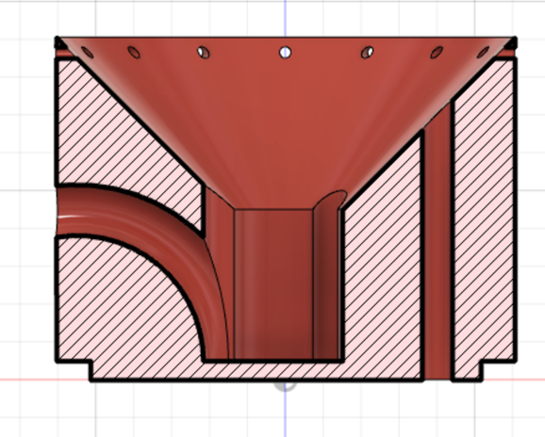
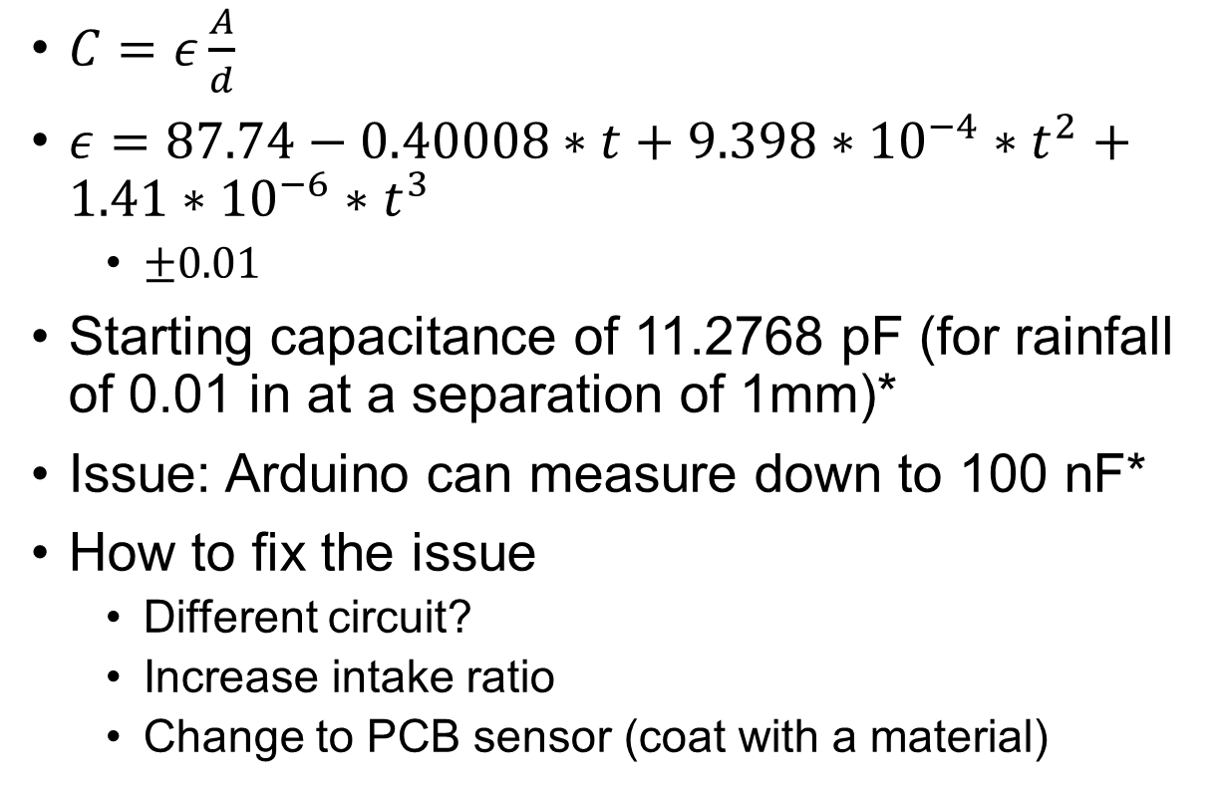
Capacitance
$C=ε\frac{A}{d}$
$ε=87.74−0.40008∗t+9.398∗{10}^{−4}∗t^{2}+1.41∗{10}^{−6}∗t^{3}$
$±0.01$
Starting capacitance of 11.2768 pF (for rainfall of 0.01 in at a separation of 1mm)*
Issue: Arduino can measure down to 100 nF*
How to fix the issue
Different circuit?
Increase intake ratio
Change to PCB sensor (coat with a material)

Slide 7
Thoughts, Question, or Advise?

